Slide 1


The Data Engineering Lifecycle

Slide 2

Agenda
Data Engineering
Examples
Lifecycle
Best Practices

Slide 3
Data Engineering
Managing Data
Data Science Adjacent
Responsible for handling all aspects of data ingestion, handling, storage, and sometimes access. Determine what happens to data when it is collected by an organization.
Hand in hand with the field of data science but not the same. As an analyst of scientist you might work closely with engineering team to determine needs and usage.
Critical component of any organization
Data pipeline and preprocessing
QA/QC of new data
Cross team collaboration
Building of databases and platforms
Facilitates efficient data analyses and report creation
Can support live systems like recommendations
Helps to standardize and/or normalize data values
Overlap between teams and jobs between SWE, DS, and Cyber
*Can be completed from home, with the option to come to campus as locations reopen (if available).

Slide 4



Industry Examples
E-Commerce: Amazon
Finance:
Etrade
Uber:
Logistics
Customer account data, real-time website traffic and interaction data, product sales data, user behavior and purchasing patterns, and many others all need to be handled differently. Leverage data to optimize logistics, leverage data to produce quality recommendations.
Real-time market data, credit monitoring data, fraud detection models, and investing platforms. Data is leverage to produce and optimize stock trading and even detect fraudulent transactions.
In the moment real-time data processing during rides and pickups. Connect customer to drivers. Store driver ratings and reviews. Leverage historical data to adjust market prices and surge timings. System for users to interact with and review drivers improves retention.

Slide 5
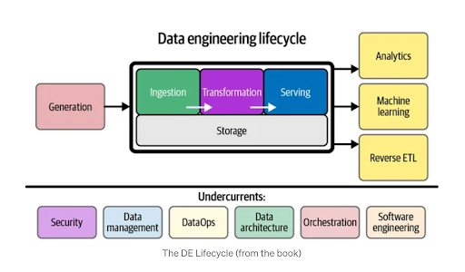
Lifecycle
Generation
Capturing and collecting ‘raw’ data from any number of sources be it website interactions or user inputted information.
Storage
How and where does the data get stored after generation including databases, data warehouses, data lakes and other forms of storage.
Ingestion
Extraction of data from source or storage into pipeline for processing and transformation. Can occur between generation and storage.
Transformation
Any processing of the data including normalizing, filtering, reformatting, and aggregating that makes the data for suitable for use.
Serving
Making processed data available to end-users, applications, or necessary systems like payment processing.

Slide 6
Data Engineering Best Practices
Data Security
Data Privacy
Three Key Aspects
Confidentiality
Integrity
Availability
Protecting data from unwanted access, misuse, or modification via engineering controls.
Engineering Controls
Access control via token or key requirements can prevent unwanted usage. Data encryption is also used to ‘hide’ sensitive information. Password authentication and 2FA logins make systems as a whole more robust.
Adherence to Law
The responsible handling and protection of personal and/or sensitive information in accordance with local governance laws and regulations. Violating data privacy laws can lead to hefty legal penalties and bad PR.
What and How
It involves the policies, procedures, and practices that govern how data is collected, processed, shared, and disposed of in accordance with legal and ethical requirements. Varies greatly based on location and country.

Slide 7
Best Practices Cont.
Data Generation
Data Storage
Data Ingestion
Data Transformation
Data Serving
In General
Necessary data only
Obtain user consent
Use encrypted forms
Secure your API
Validate user input
Clean/sanitize user inputted data
Trying to prevent malicious code from being injected into your system or database
Encrypt sensitive data
Implement access control tool/system
Run regular security audits on systems
Implement robust data backup and recovery processes
Sensitive customer information like credit card data and personal identification should receive special consideration.
Secure internal data transfer channels
Utilize authentication for login and data access
Implement robust data validation to handle anomalies in data
Whether it is ‘new’ data being ingested or existing data, validation can help control against unwanted information
Apply masking or tokenization/encoding to protect highly sensitive information
Use secure coding environments
Implement access controls and logs to monitor and adapt
Regular reviews of access logs via a program or human can act to identify unwanted actors
Implement secure API and authentication method for access
Can utilize data filtering to limit exposure of sensitive information
Rate limit and/or throttle API access to prevent DOS and brute force attacks
By utilize data aggregation and filtering you can prevent raw data from being accessible
Regularly update, test, and patch systems
Conduct security assessments and penetration testing
Implement a ‘least privilege’ access control scheme
Provide training on data privacy and security threats
Ensure compliance with all data protection regulations and laws

Slide 8
Summary
Data Engineering
Lifecycle
Best Practices
What and How
Managing Data
Across Stages
We talked about the importance of data engineering in determining not only what data is being collected but also how it is being stored and processed.
We talked about the data engineering lifecycle, broken down into 5 stages related to processes being run on the data.
We talked about some high level best practices and considerations when involved in the data engineering process with an emphasis on data security and privacy.

